Slide 1


ALL ABOUT YEAR 1/2
Duke of Norfolk School
BY PAISLEY AND FLORENCE

Slide 2
ALL About Year 1/2 Classrooms
Time line
Birthday Wall
House Points
White Board
Fan
Clock
Sink
Soap
Tables
Chairs
Paper Towls
Books
Water Bottles
Baskets
Pencils

Slide 3
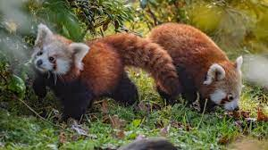
Year ½ Class Trip
Red pandas are cute.
They are so cute and fluffy!

Slide 4
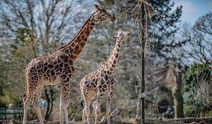

Chester ZOO
Did you know that giraffes have a blue tong
It’s a great place!

Slide 5
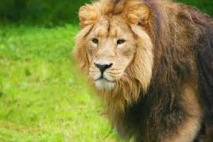
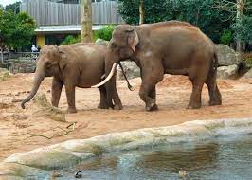
About Lion and Elephants
They are cute.
They have tusks.

Slide 6

PE
PE is really fun!

Slide 7

Science
I love Science

