Slide 1

Clem and Crab
Written by Fiona Lumbers

Slide 2
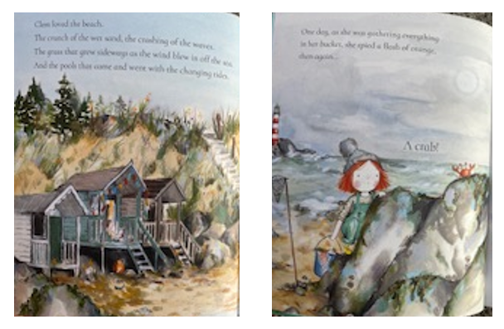

Slide 3
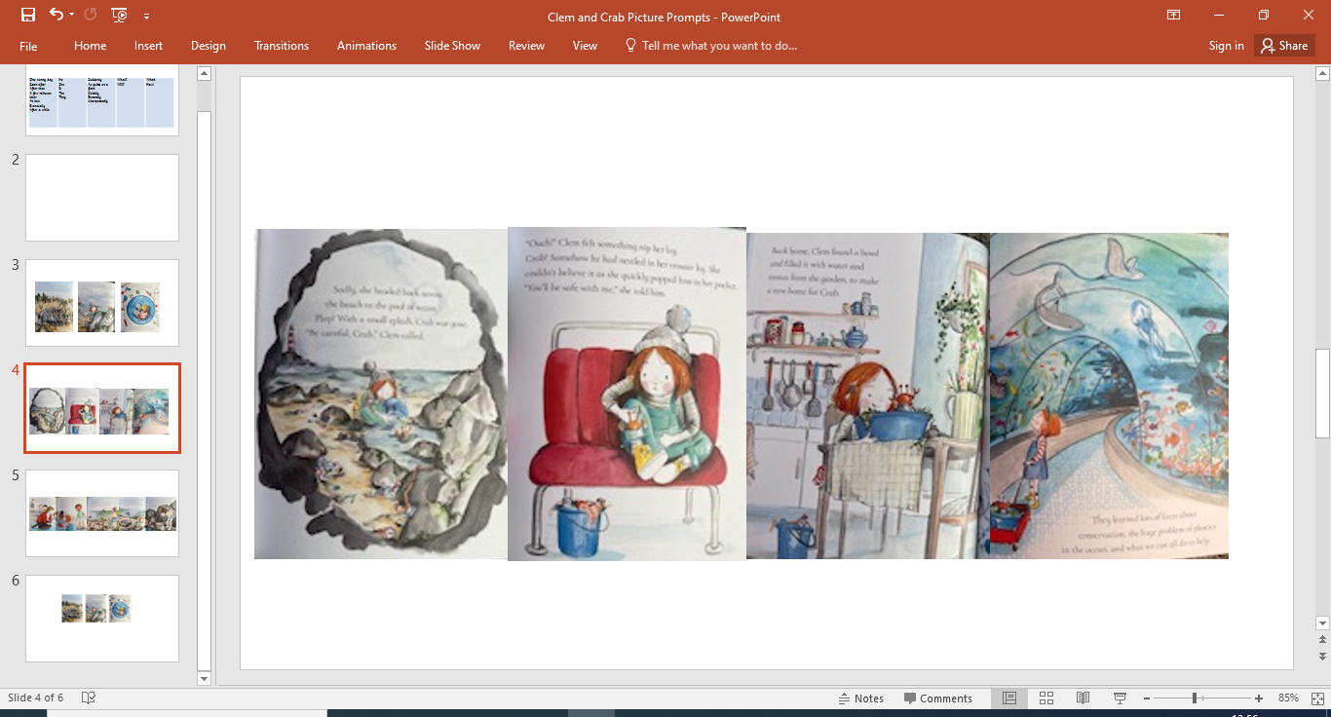

Slide 4


