Slide 1

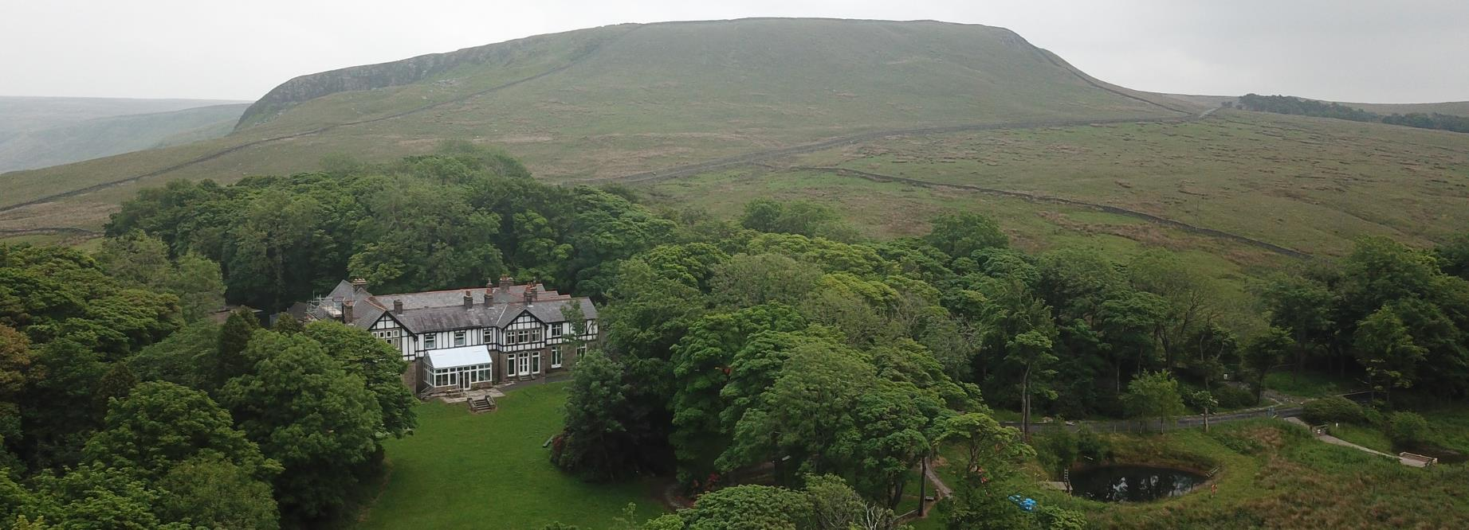


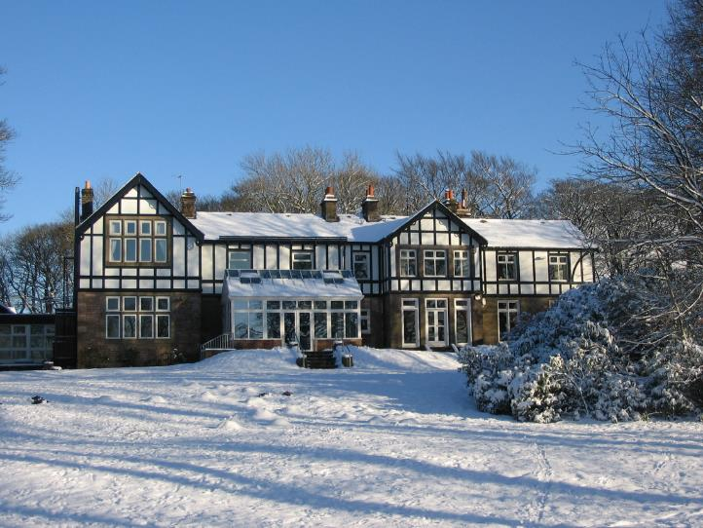
Notes:
We recommend that you have the info for staff and parents handy so any extra questions can be asked.
Each slide has notes if needed.
This is not timed so you can go at your own pace.

Slide 2


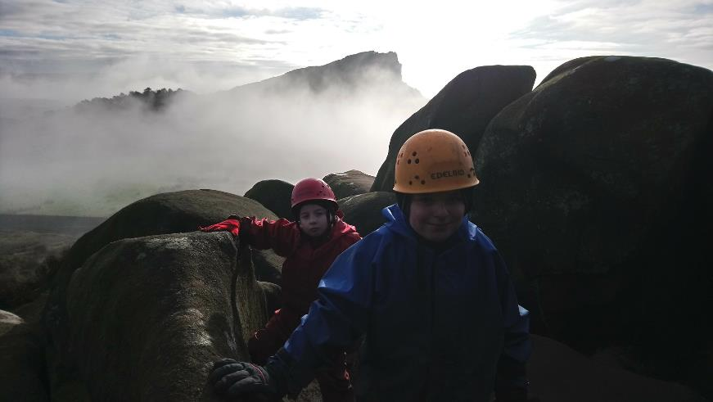

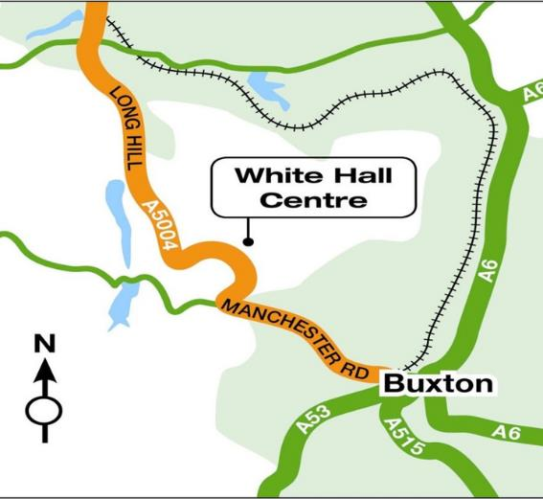
Where are we?
In the heart of the Peak district
Notes:
White hall is in the heart of the Peak District. In the Peak District National Park and 4 miles outside Buxton. At 400 meters White Hall has stunning views of the Goyt Valley and the moors around. Visits to White Hall experience the large grounds (35 acres of woods, ponds and fields) but also the stunning countryside around.

Slide 3
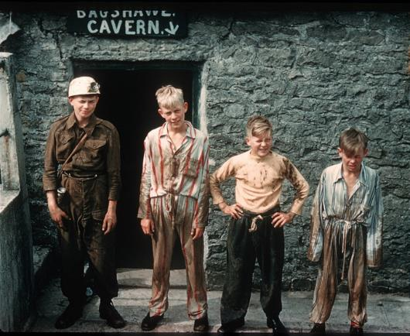
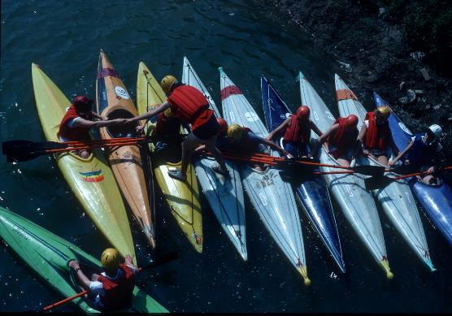
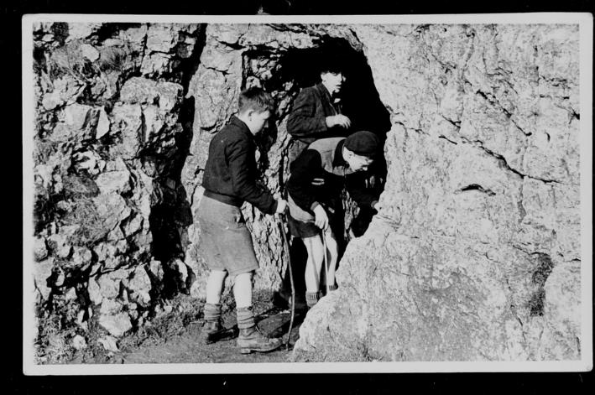

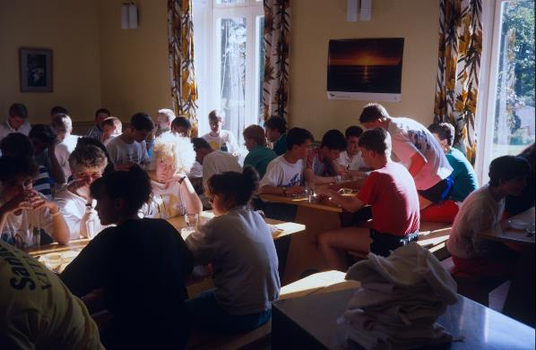
70 years plus of outdoor provision
Personal development and education has been at the heart of White Hall from the beginning.
Notes:
White Hall was the first local authority outdoor education center in the UK. Over those 70 years over a million young people have experienced the White Hall Adventure. It has also trained many instructors, teachers and youth workers in that time.

Slide 4
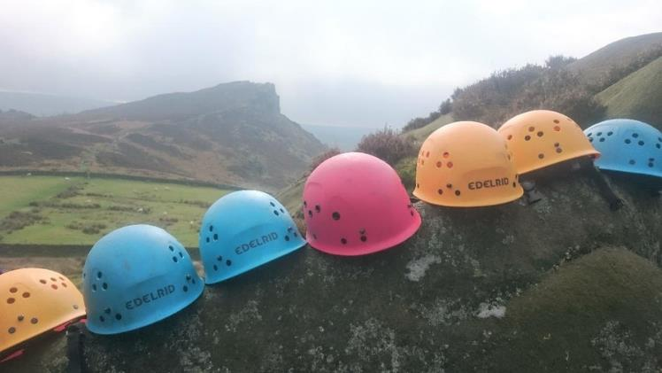



Why come to White Hall?
Notes:
The courses, which White Hall and school plan includes exciting adventure activities using real rock, caves, lakes and hills.
White Hall has robust safety procedures and policies. The safety and welfare of everyone who comes to White Hall is the priority.
White Hall holds a licence from the National Adventure Activity Licencing Authority –this means they are approved to deliver outdoor activities. It indicates and assesses that the centre has been inspected with attention paid to their safety management systems and that they work to nationally accepted standards of good practice.
They also hold the Learning Outside the Classroom Award.
All of the instructors are highly qualified in the activities they deliver and have a wealth and depth of experience of working in outdoor education.
They will do everything they can to ensure the experience will be safe, educational and fun in a caring, welcoming environment.

Slide 5
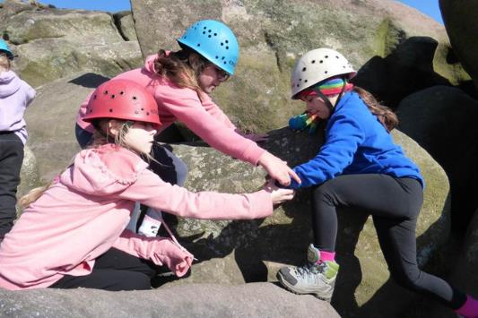
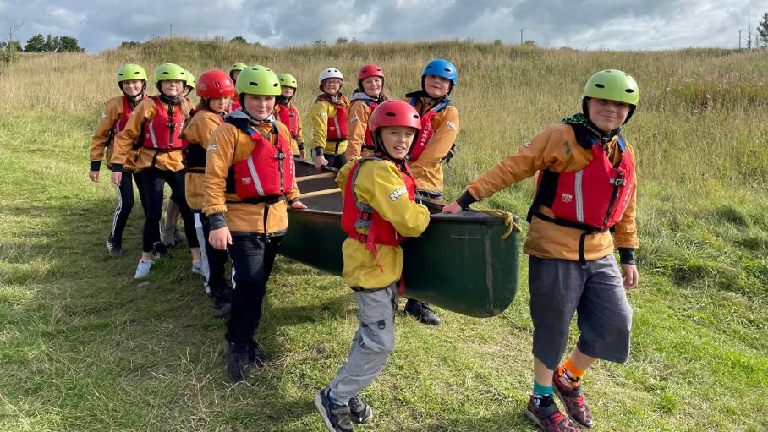
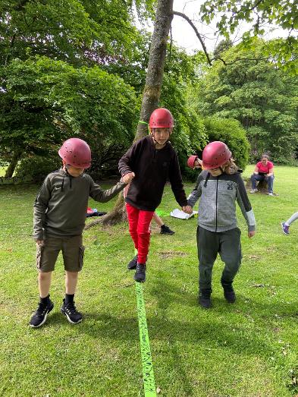
To encourage working together

Slide 6
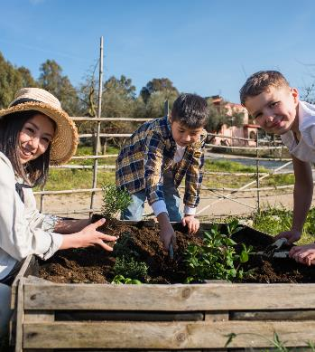
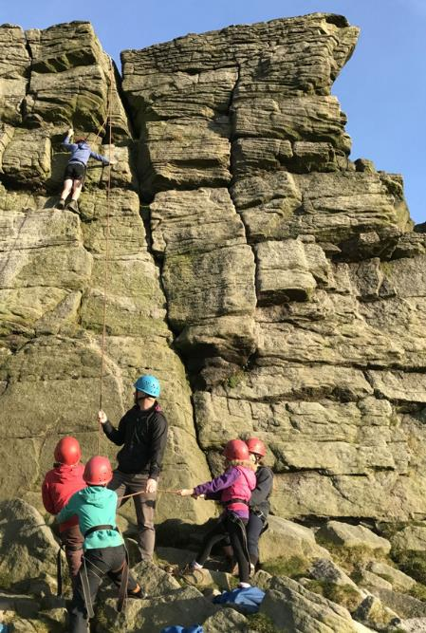
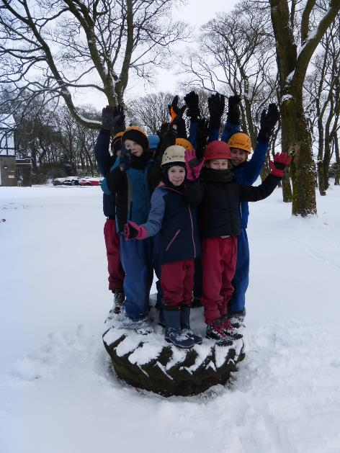
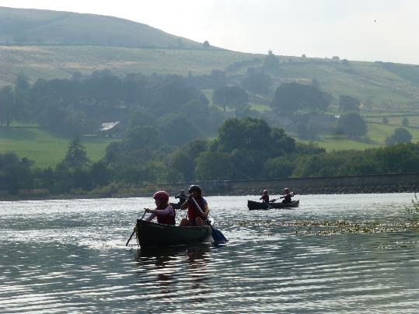


Improve communication skills

Slide 7
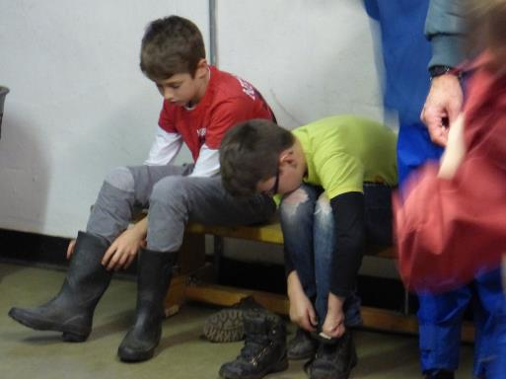
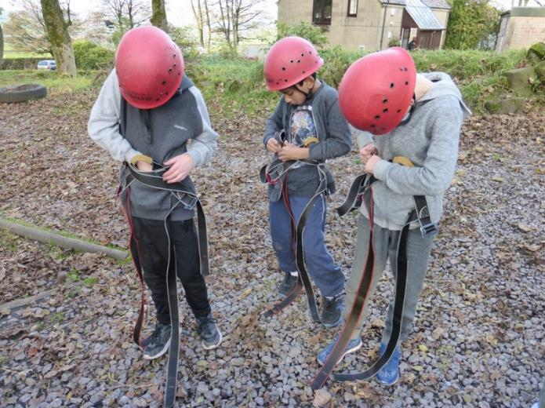
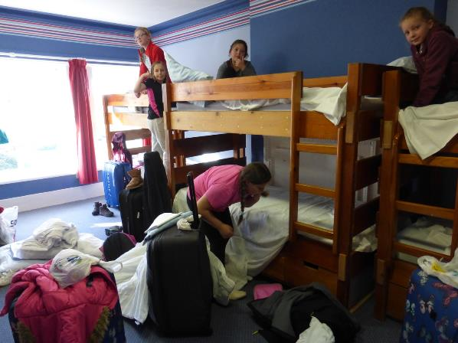
Gain Independence and self reliance

Slide 8
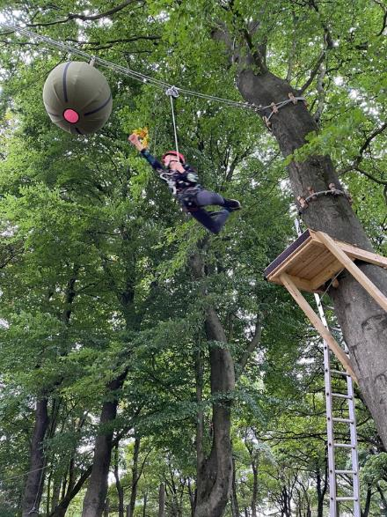
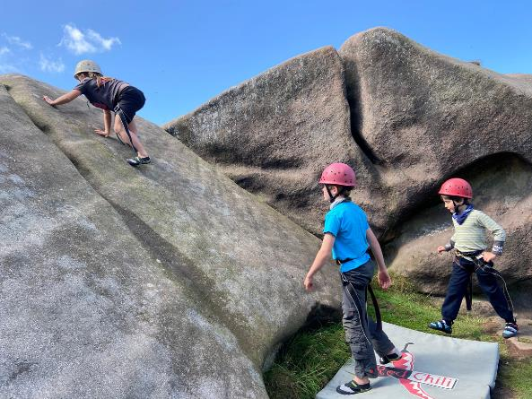
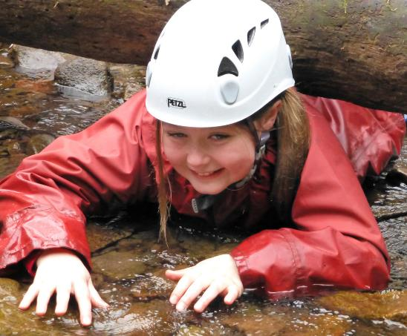
To overcome challenges
and become more confident

Slide 9
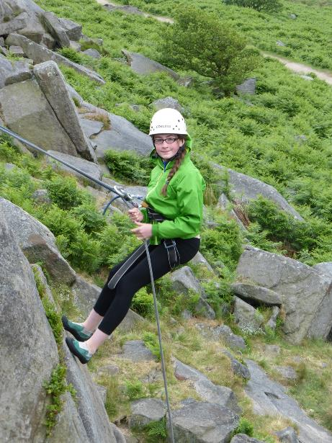
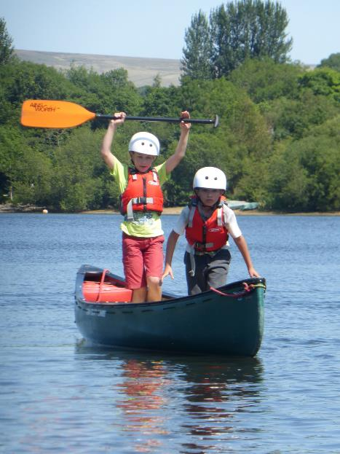
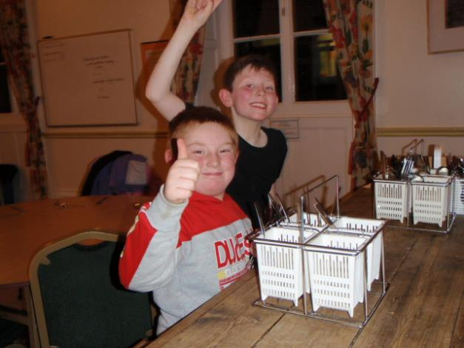
Acheive success and develope a positive attitude

Slide 10


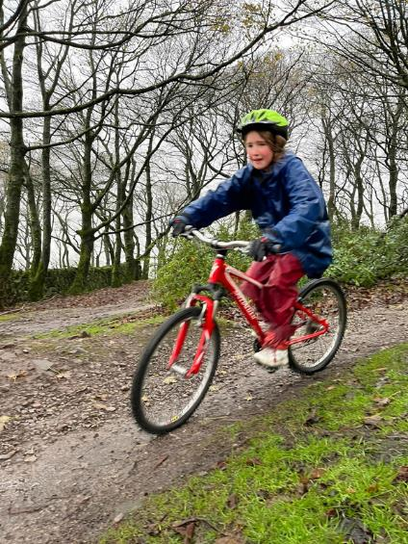
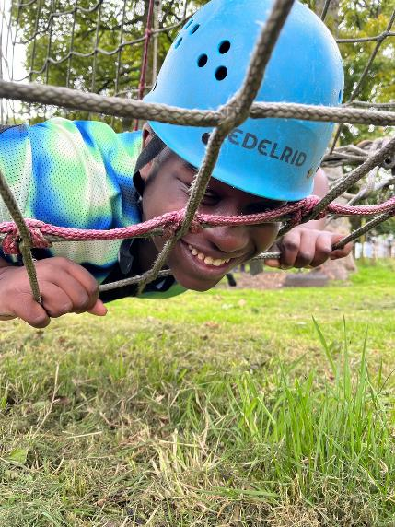
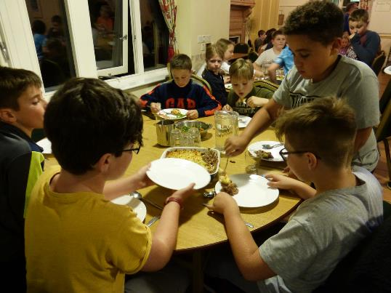

HOW?
FUN
THROUGH ACTIVITIES
THROUGH A SHARED RESIDENTIAL EXPERIENCE

Slide 11


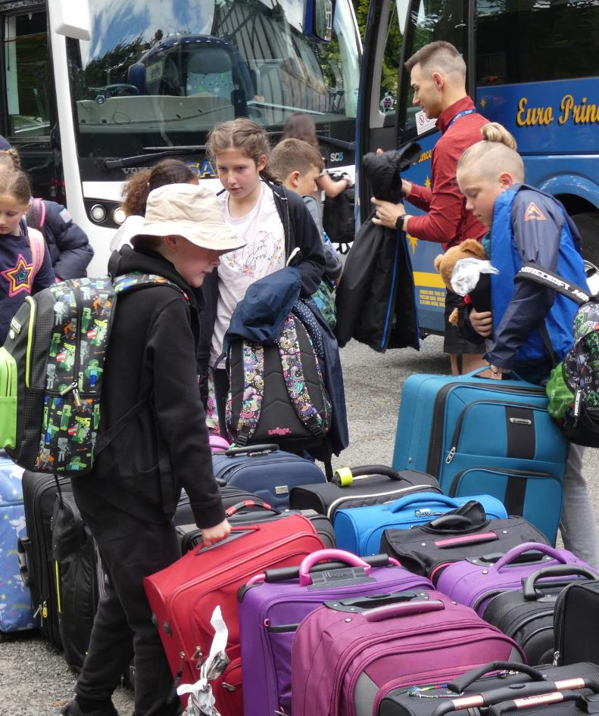
SO WHAT’S YOUR STAY AT WHITE HALL GOING TO BE LIKE?

Slide 12


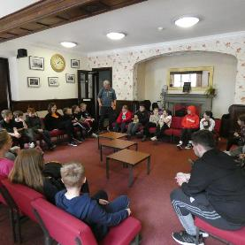
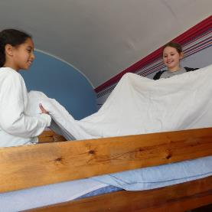
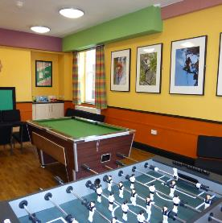
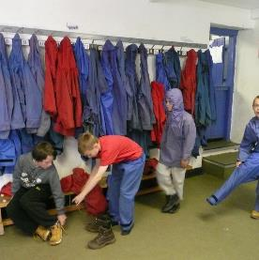
When you arrive there is time :
for a welcome chat
to settle into your dorm and make your beds
get to know the centre
find your peg and get your equipment
Notes:
White Hall works with the school to reinforce all the school values and rules. We have a few extra to help keep everyone safe:
separate girls and boys dormitary areas, no phones or cameras in dorms or changing areas and bedrooms are private spaces just for those people.
All bedding is provided by the centre. We ask children to make their beds helping to foster a sense on independence.
Every child gets their own peg where they can leave waterproofs and boots that they can borrow from White Hall.

Slide 13

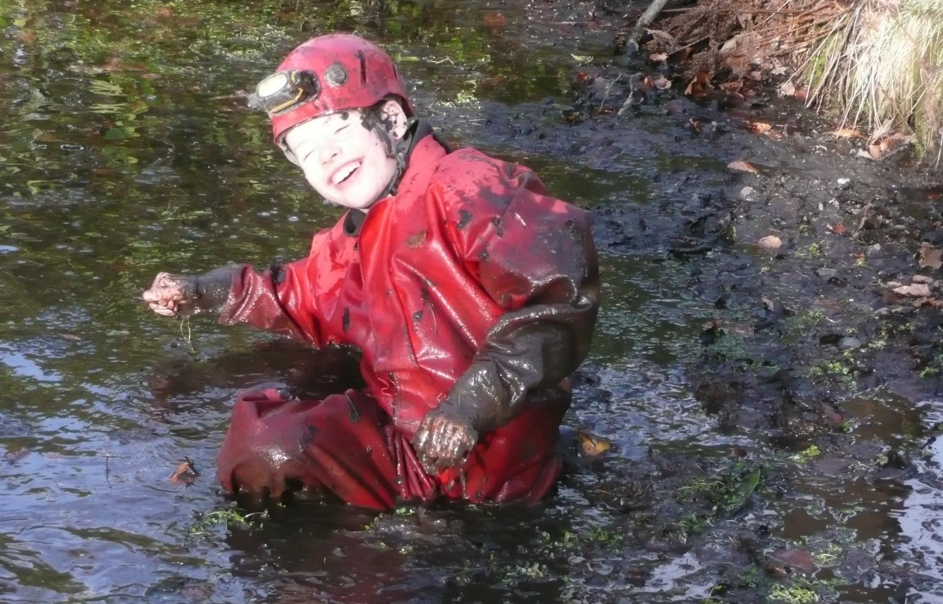
Time to get outside and stuck in!

Slide 14
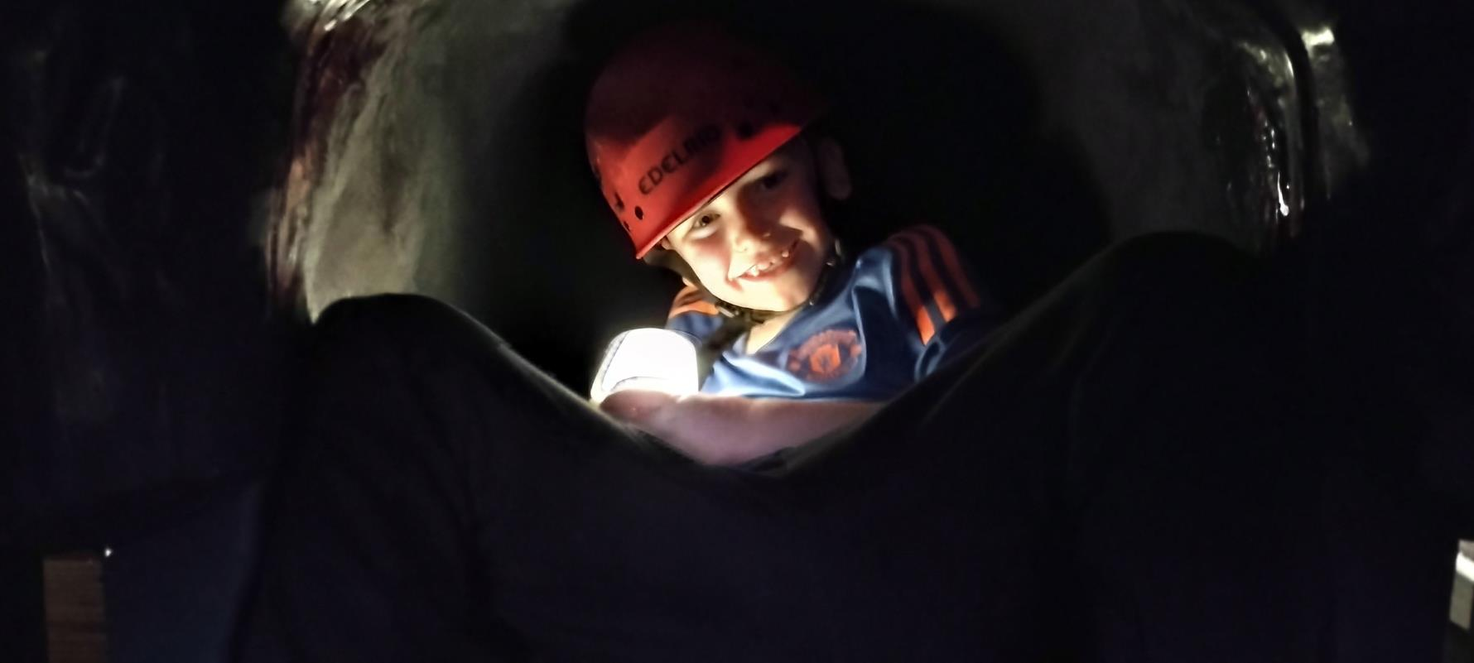
During your stay you may do some of the following .

Slide 15
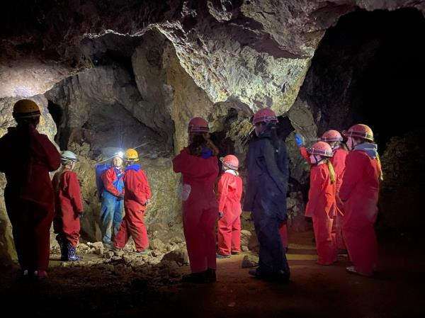
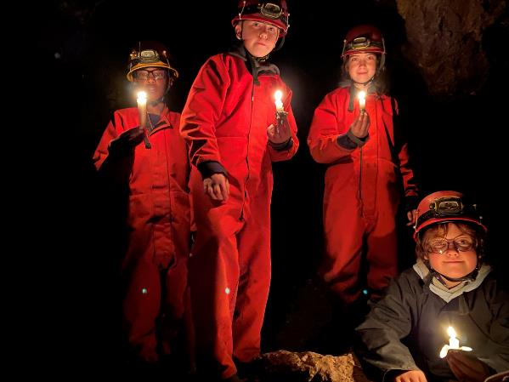
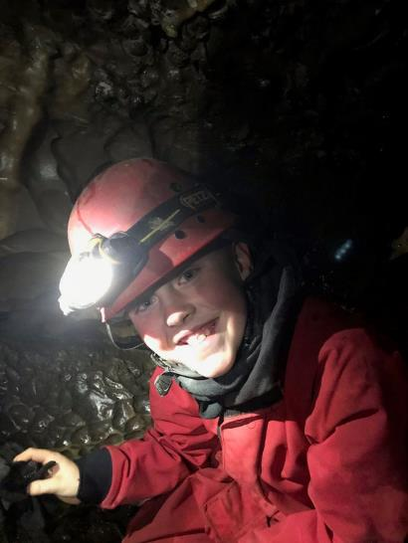
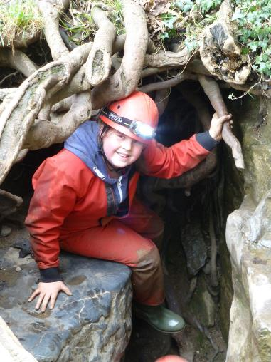
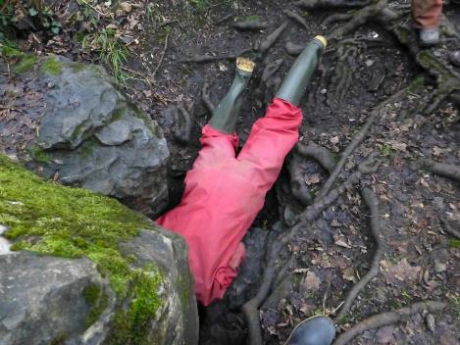
Explore the amazing underground world and overcome fears

Slide 16
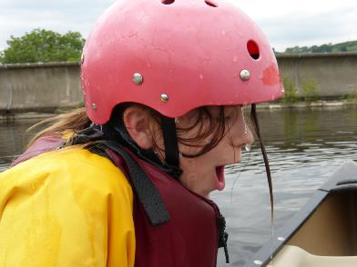
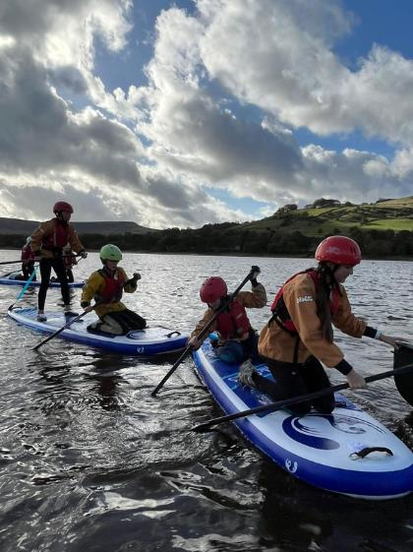
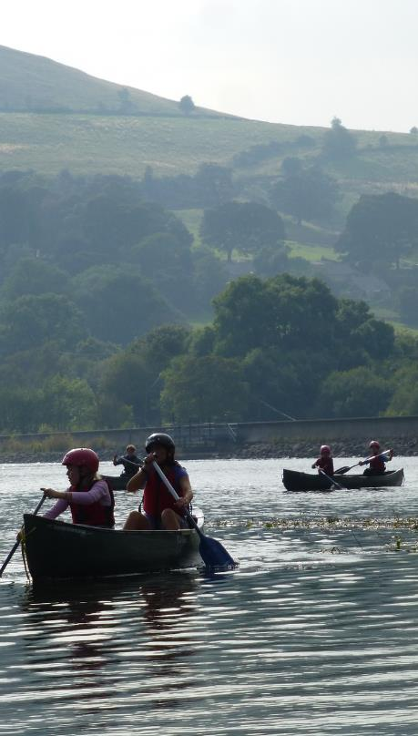
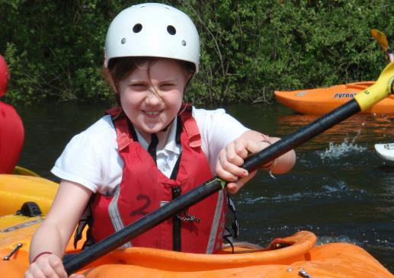
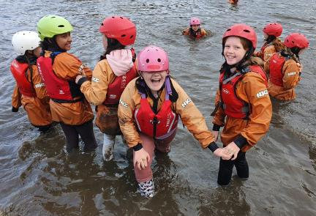
Help your team to paddle in a straight line, journey to the other side of the reservoir and maybe get a little wet!

Slide 17
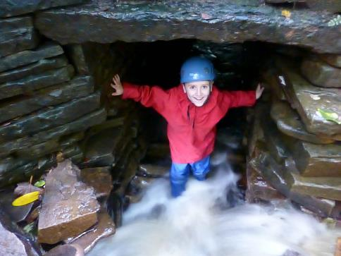

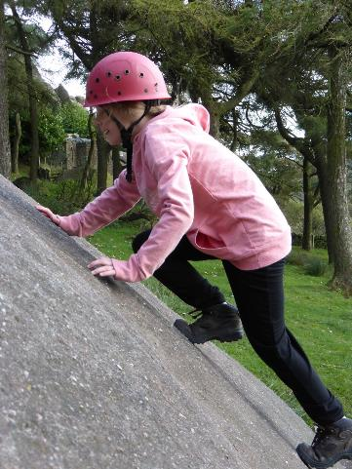
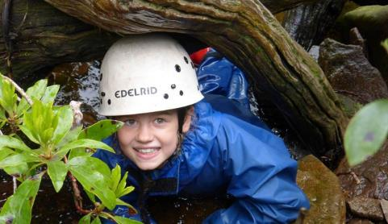
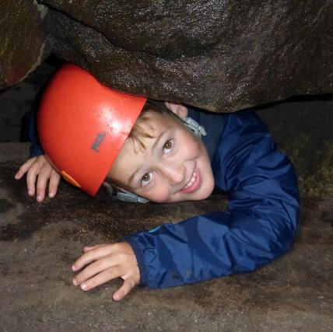
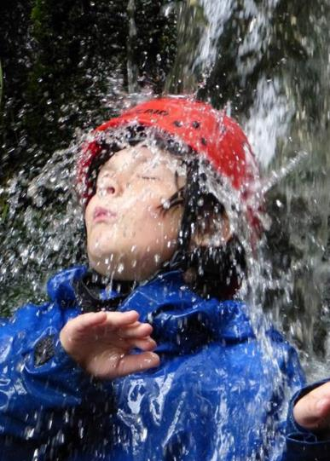


Gain confidence scrambling, whether on the rocks or in the water.

Slide 18




Achieve success on a rope

Slide 19












And so much on site

Slide 20















To keep energy levels up, all White Hall meals are delicious, healthy and home cooked.
And there are a few duties to be done after meals.
Notes:
All meals at White Hall are home cooked. We can cater for any dietary need but we do need advance notice. We are a nut free centre. Meals are family style where everyone sits, serves and chats together.
After meals there are a few simple chores/duties to be done.

Slide 21






THE ADVENTURES DON’T STOP AT TEA.
Night Hike
Wide games
Shelter building
Test your map reading and lead your team on a night walk
Pit your wits against your staff and other teams.
Test your building skills against a “hurricane”

Slide 22



And there is always a little free time.
Notes:
Free time – it is a busy few days but there is some time where children have a bit of time to play, rest, socialise with each other - supervised by school staff.

Slide 23



Then it’s time for supper and bed.
Notes:
Hot chocolate and biscuits.
Bed time to be decided by school staff but we have a general rule of quiet time between 11pm and 7.30am.
There is a member of White Hall staff on duty overnight if there is an emergency.

Slide 24

Frequently asked questions.
  Are White Hall staff qualified?
1
  Will it just be our school?
  2
  What if the weather is bad?
  3
  Do we have the same instructor all week?
  4
  What about special diets?
  5
Notes:
1. All staff have the appropriate National Governing Body Qualifications and training. All staff including house staff are first aid qualified and have been DBS checked.
2. You may be sharing with another school but if so it will be with children of a similar age. Children will be in dormitories and activity groups with other children from their own school.
3. We monitor the weather constantly and will change activities if needed to keep everyone safe.
4. Whenever possible we like to keep the same instructor with each group, so they can get to know their needs and tailor the activities appropriately.
5. White hall caters for all dietary needs - we just need to know in advance. We are a nut free centre.

Slide 25
Frequently asked questions.
How secure is White Hall?
6
Is White Hall insured and Licenced?
  7
  How do I contact the centre in an emergency?
  8
  Do I need a sleeping bag?
  9
  What to pack?
  10
Notes:
6. White Hall is very security conscious - external doors only open from the inside unless there is a key code, we have security cameras and a robust visitor policy.
7. White Hall is owned and run by Derbyshire CC. As part of Derbyshire County Council White Hall has public liability insurance.
Schools and individuals are advised to take out insurance against personal injury, cancellation, loss or damage and ill health.
White Hall holds a licence from the National Adventure Activity Licencing Authority –this means they are approved to deliver outdoor activities. It indicates and assesses that the centre has been inspected with attention paid to their safety management systems and that they work to nationally accepted standards of good practice.
We also hold the Learning Outside the Classroom Award.
8.
1. via the school
2. via the centre office -
01298 23260
3. at night via the duty phone - 07900 617222
9. White hall provides all bedding.
10.
What should you pack – A full list will be sent out to school. Please don’t buy waterproofs and boots especially for the trip as WH provide them. We recommend that electronic items, mobile phones and valuable items are left at home as we are unable to look after them. We also advise against packing new clothing for the activities. WH ask that participants not to wear jewellery during activities.
Remember - old clothes, plenty of warm layers, no jeans for activities, some long sleeves/trousers even in the summer.

Slide 26


































What to pack?
Only if you have
for wet activities

Slide 27






Top tips from White Hall
  Name everything
  Learn to make your bed
  Learn how to tie your shoelaces
  Don’t bring anything valuable
Joe Bloggs

Slide 28

We can‘t wait to meet you.

Slide 29
Find us at:
https://whitehall.derbyshire-0utdoors.org/
www.facebook.com/whitehallderbyshire
https:/www.instagram.com/whitehall.centre

